Slide 1
RESTAURANT SUGGESTION SYSTEM
14/11/2020 IBM CAPSTONE PROJECT

Slide 2
METHODOLOGY
Machine Learning
Exploratory Analysis
Inferentail Analysis
RECOMMENDER SYSTEM

Slide 3
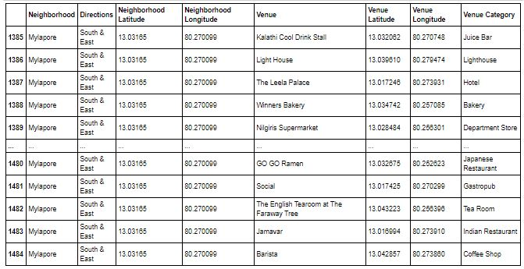
DATASETS

Slide 4
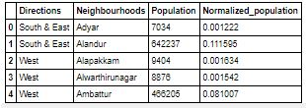
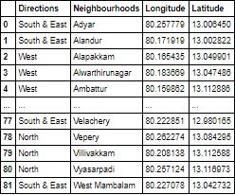
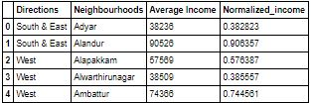

Slide 5
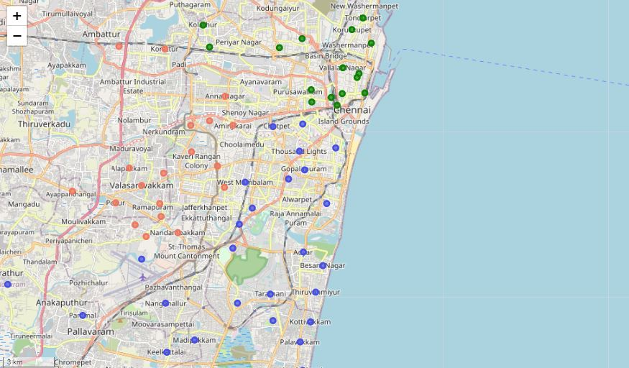
MAPPING

Slide 6
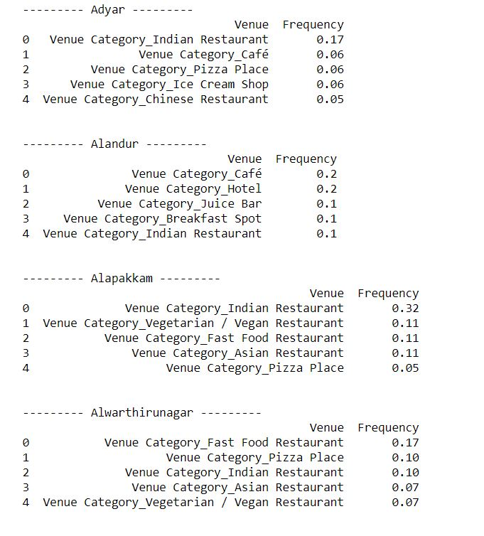
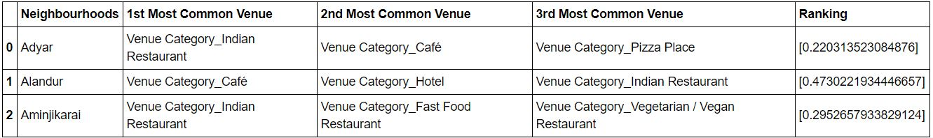
RESULTS & CONCLUSION

Slide 7
THANK YOU !

